Slide 1
Heart stroke prediction
Sai Pradeep Peri – sap187

Slide 2

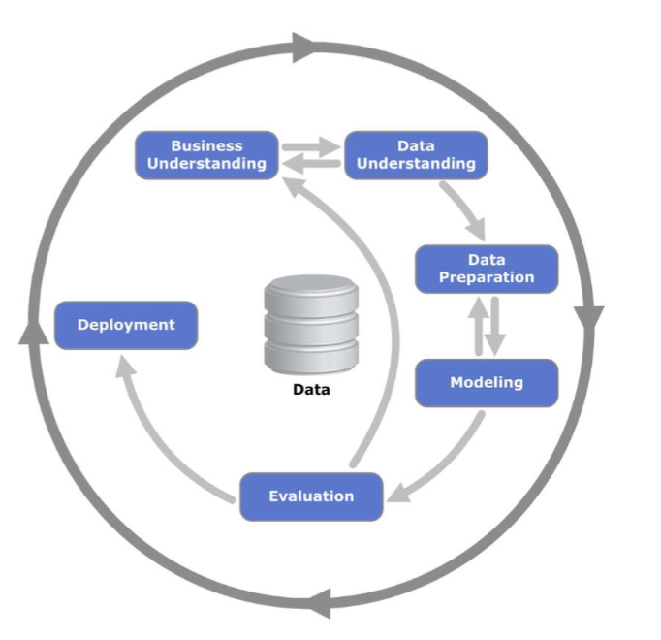

CRISP - DM
CRISP-DM stands for cross-industry standard process for data mining.
The CRISP-DM methodology provides a structured approach to planning a data mining projects.

Slide 3


Business Understanding

Slide 4
Introduction to the problem
American Heart Association statistics :
Death due to stroke occurs every 4 minutes
Daily Death Rate -> 389.4
Costs $34 billion a year (estimated)
46% of US adults suffer from hypertension

Slide 5

Problem statement
Our project aims at making an analysis to predict the chances of heart-stroke beforehand in order to create awareness. Hence, precautionary measures can be taken.
Is there a way to reduce the heart-stroke incidence by analysing patient’s lifestyle data?
We are using Kaggle dataset for analysing this problem - Healthcare Dataset Stroke Data - https://www.kaggle.com/asaumya/healthcare-dataset-stroke-data

Slide 6

Data understanding

Slide 7
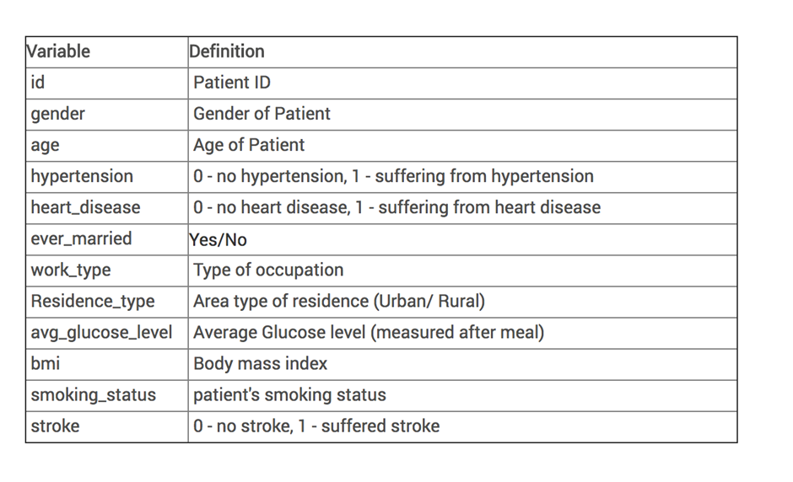
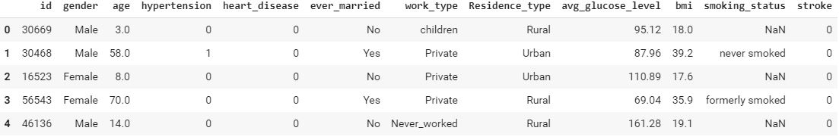

Slide 8
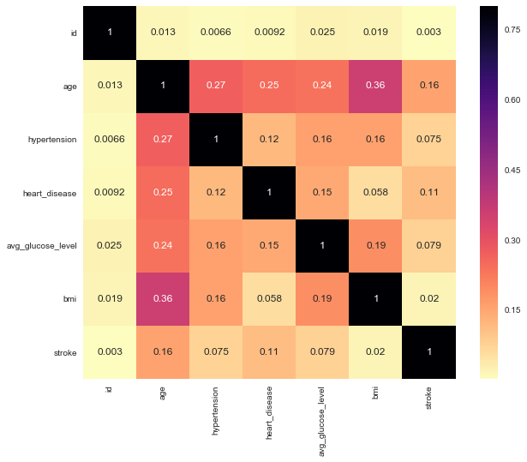
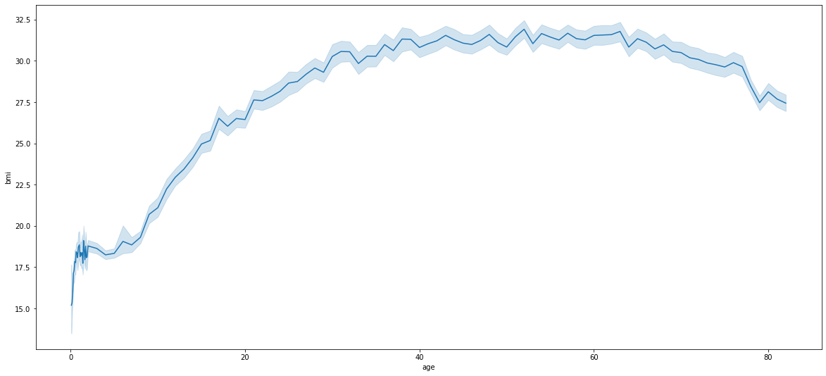

Slide 9
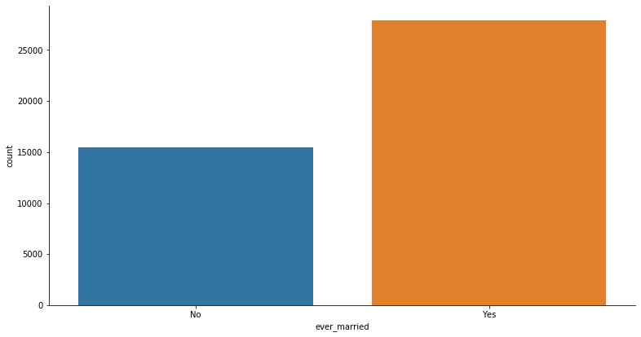
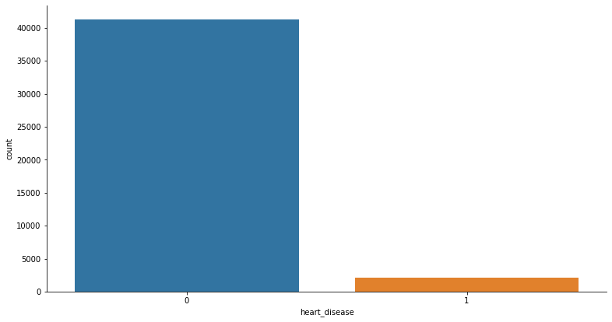
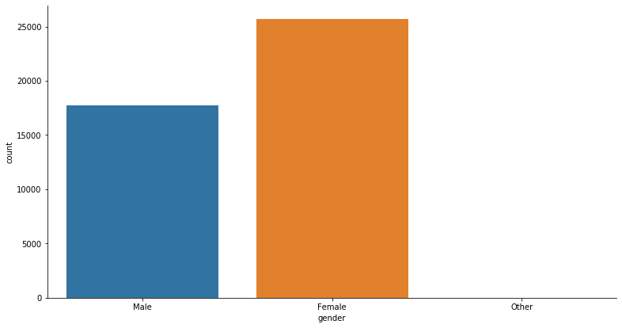
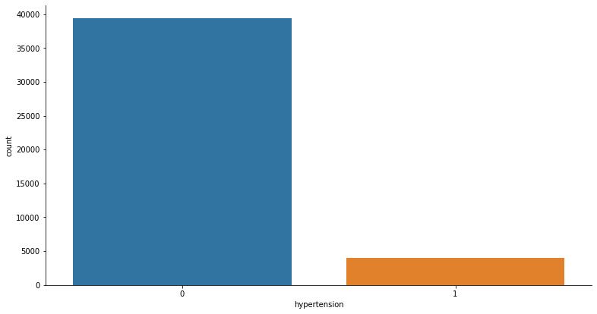

Slide 10
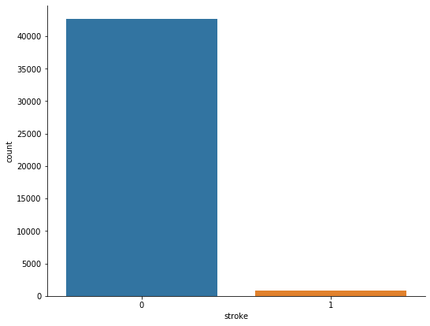
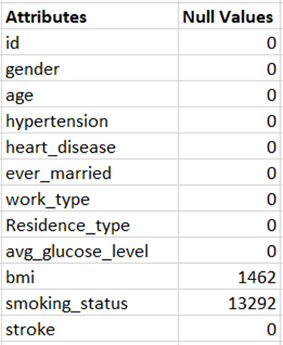

Slide 11
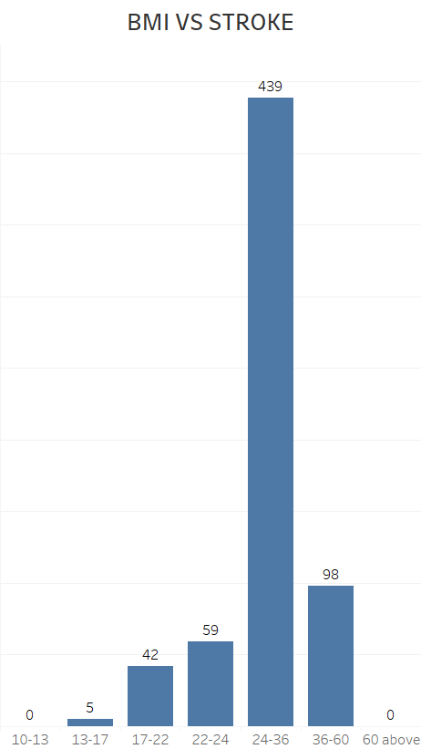
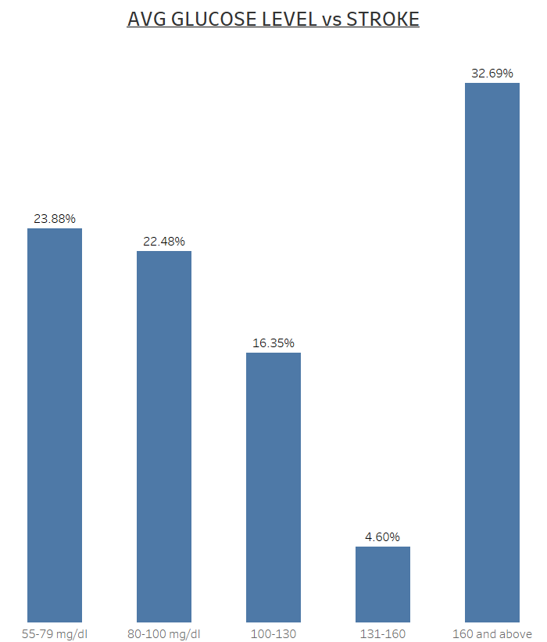
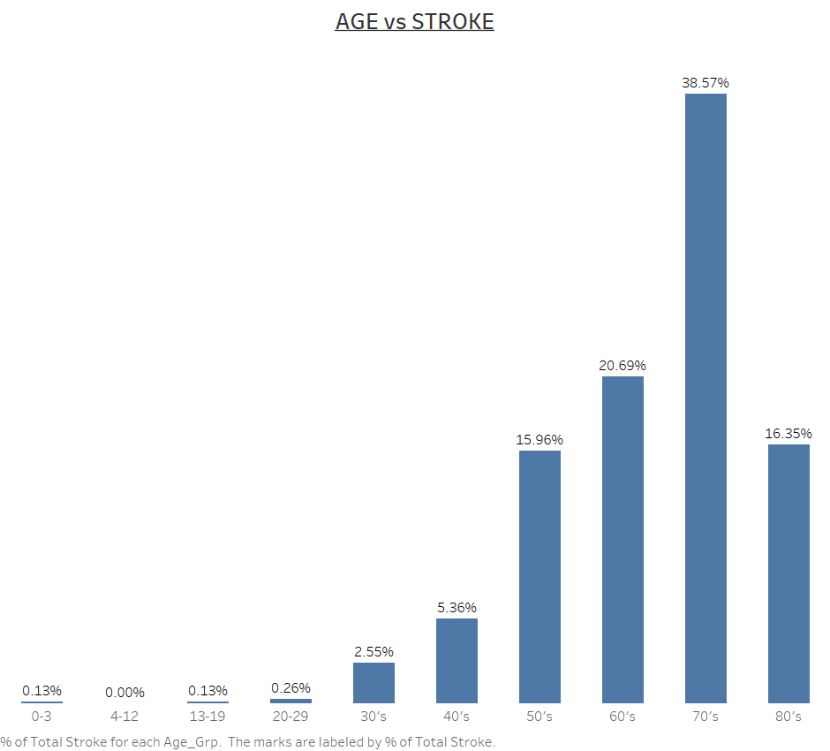

Slide 12
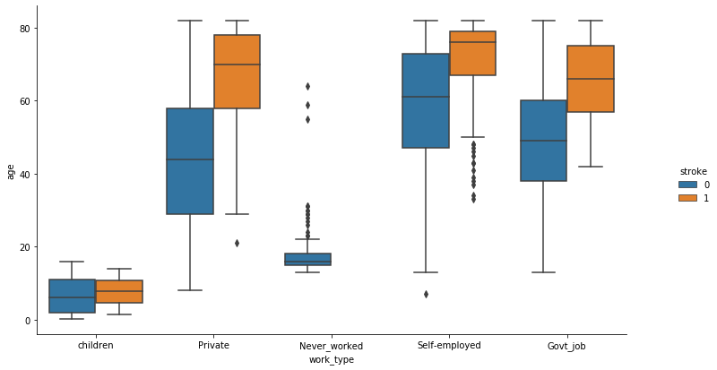
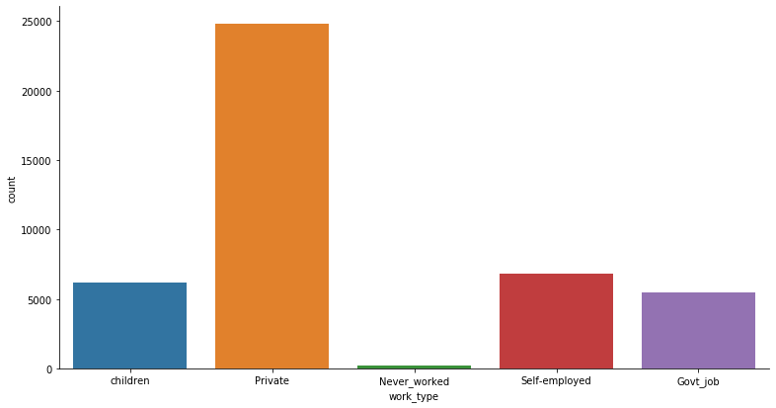
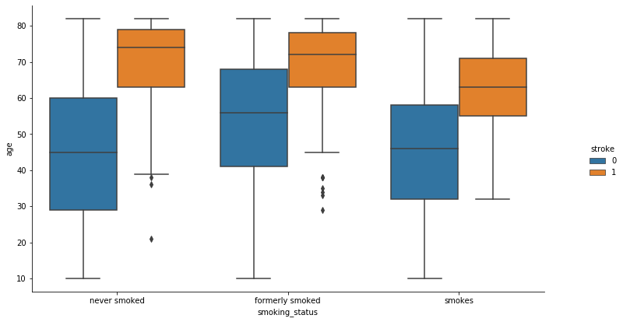

Slide 13

Data preparation

Slide 14
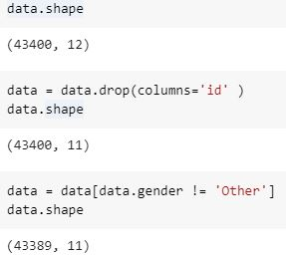
Data cleaning
Column ‘id’ is dropped from the table
Rows with ‘gender = Other’ are removed Only 11 rows.
Now, other dataset contains 11 attributes and 43389 observations

Slide 15
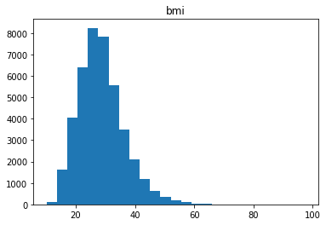
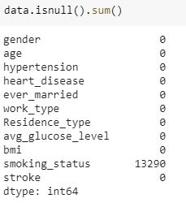
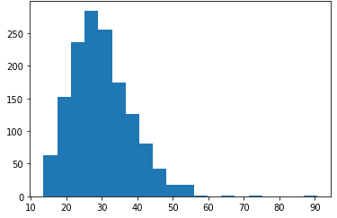
Handling missing values
Attribute BMI has 1458 missing values
This represent nearly 20% of the data in which the event is occurring (~141/783)
We cannot ignore these rows
The attribute values are distributed as seen in the graph
Generate random values based on the bmi distribution graph

Slide 16
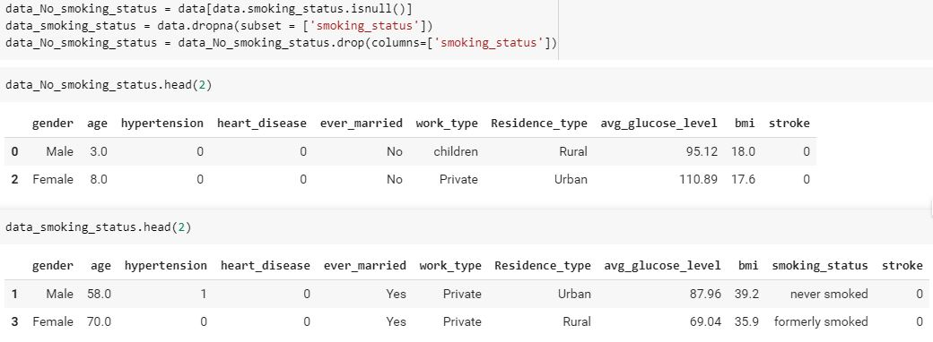
Attribute smoking_status has 13290 missing values. Roughly 30% of dataset
We can split the dataset based on this attribute.
The data is split into two separate dataset - one including the smoking status and one
not including the smoking status

Slide 17
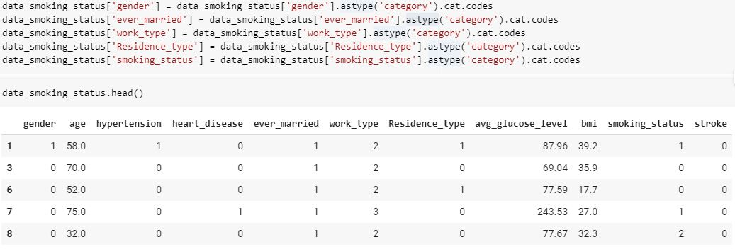
encoding
Attributes gender, ever_married, work_type, residence_type, smoking_status have categorical values
We transform them to numerical values

Slide 18
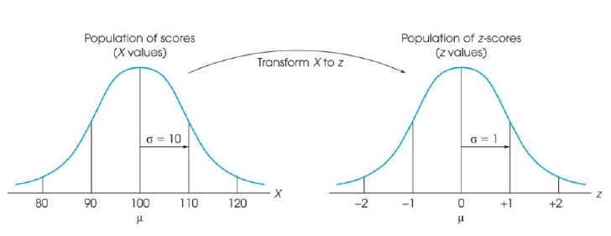


Normalization(Scaling)
The goal of normalization is to change the values of numeric columns in the dataset to a common scale, without distorting differences in the ranges of values.
We used StandardScaler, the standard score of a sample x is calculated as: z = (x - u) / s where u is the mean of the training samples or zero if with_mean=False, and s is the standard deviation of the training samples or one if with_std=False.

Slide 19

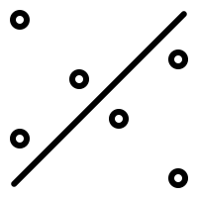
modeling

Slide 20
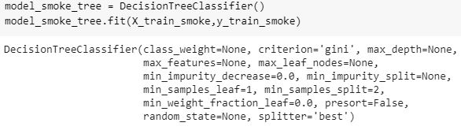
Model Used: DecisionTree Classfier Train & test split for two datasets:
Modeling is performed on two data sets which we split in the preparation part(one with smoking status and other without smoking status).

Slide 21


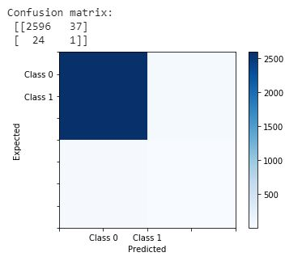
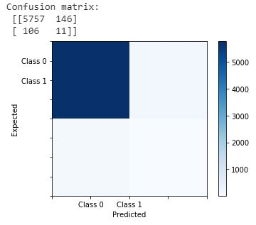
Results?

Slide 22
WHAT WAS THE PROBLEM?
The number of stroke observations are not equally distributed. Large amount of data/observations are present for stroke = 0(majority class), and much fewer observations for stroke = 1 (minority class).
The above figure shows the stroke values of smoking and non-smoking data combined

Slide 23
Data preparation (contd.)

Slide 24
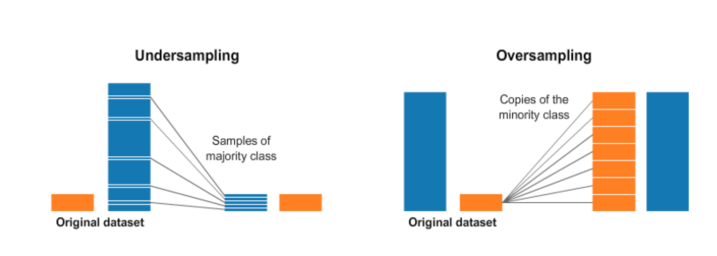
To deal with the imbalance problem of the dataset we have resampled the dataset by performing both Undersampling and Oversampling on the data.
Undersampling deletes some of the observations from the majority class in order to match the numbers with the minority class.
Oversampling generates synthetic data that tries to randomly generate a sample of the attributes from observations in the minority class.

Slide 25
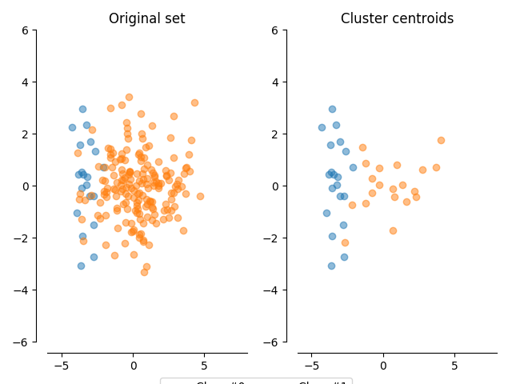

APPROACH FOR UNDERSAMPLING:
We considered two undersampling techniques on the data:
Random under-sampling for the majority class:
This technique under-samples the majority class randomly and uniformly.
Drawback: This can potentially lead to loss of information.
ClusterCentroids:
Method that under samples the majority class by replacing a cluster of majority samples by the cluster centroid of a KMeans algorithm. This algorithm keeps N majority samples by fitting the KMeans algorithm with N cluster to the majority class and using the coordinates of the N cluster centroids as the new majority samples. We opted for Cluster centroids.

Slide 26
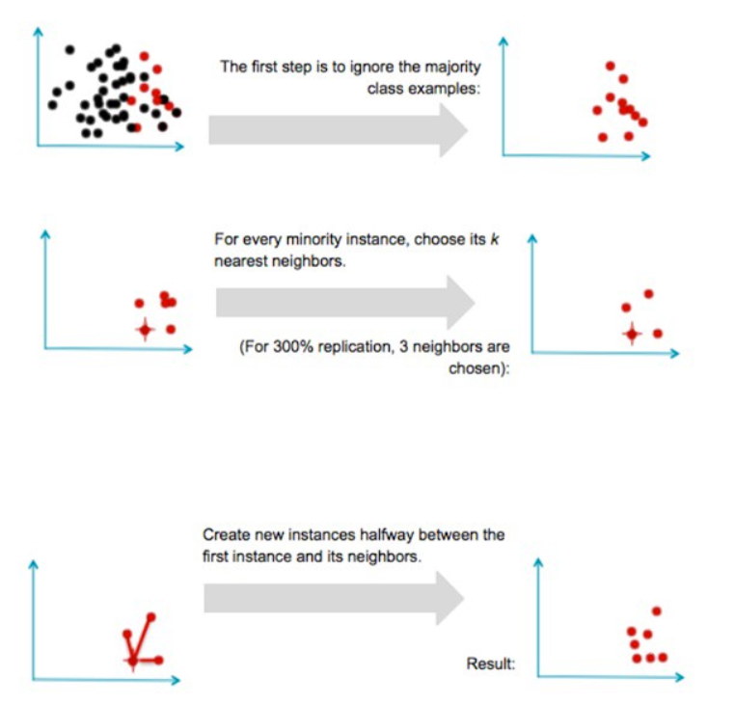

APPROACH FOR overSAMPLING:
We considered two oversampling techniques on the data:
Random over-sampling for the majority class:
In random oversampling technique we replace the samples with existing minority samples. In simple terms we can say that we just do multiplication of existing Minority class.
Drawback: This technique is highly prone to over fitting.
Synthetic Minority Over-Sampling Technique(SMOTE):
SMOTE oversamples the minority class, it does not rely on reusing previously existing observations. Instead, SMOTE creates new (synthetic) observations based on the observations in data.
Depending upon the amount of oversampling required , neighbours from k-NN are randomly chosen
SMOTE

Slide 27
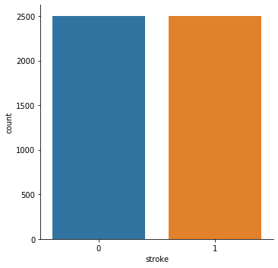

Slide 28
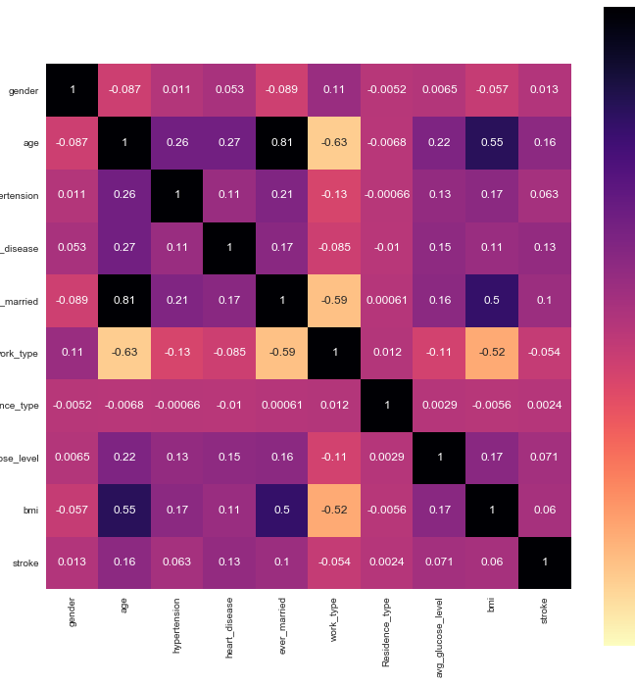
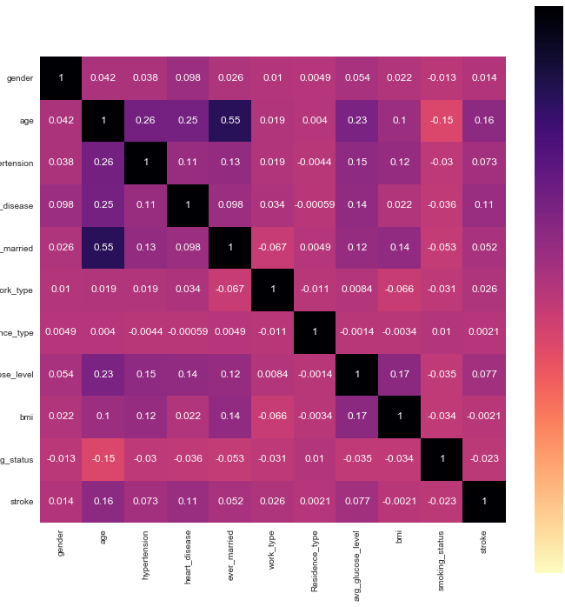
data after resampling
Without Smoking Status
With Smoking Status

Slide 29
modeling (Contd.)

Slide 30
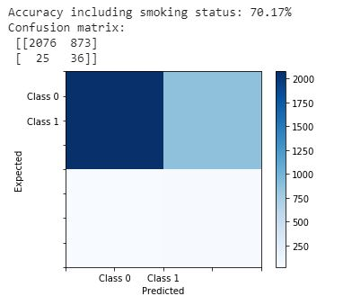
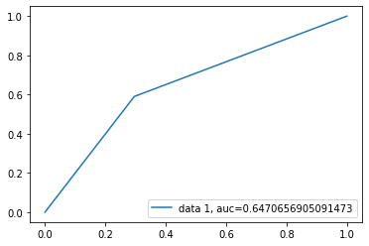
CLASSIFICATION INCLUDING SMOKING STATUS:
Decision Tree Classifier:

Slide 31
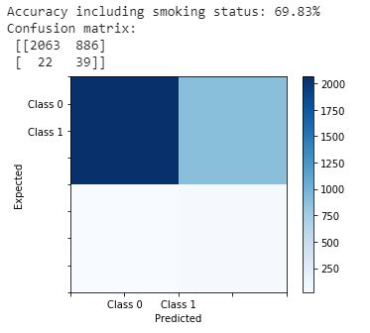
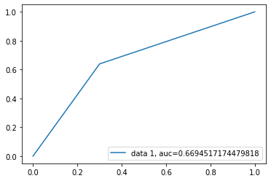
CLASSIFICATION INCLUDING SMOKING STATUS:
Support Vector Machines:

Slide 32
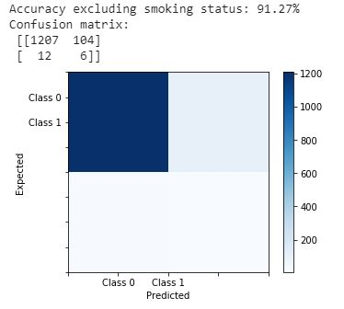
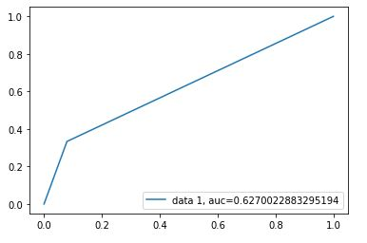
CLASSIFICATION without SMOKING STATUS:
Decision Tree Classifier:

Slide 33
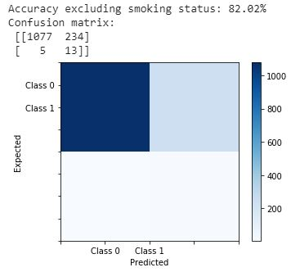
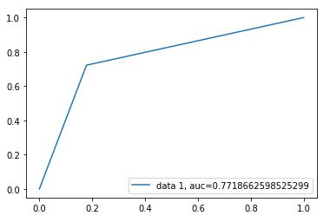
CLASSIFICATION without SMOKING STATUS:
Support Vector Machines:

Slide 34

evaluation

Slide 35
Validation curves
Validation Curves are used to determine how effective an estimator is on data that it has been trained on as well as how generalizable it is to new input. To measure a model’s performance we first split the dataset into training and test splits, fitting the model on the training data and scoring it on the reserved test data.
In order to maximize the score, the hyperparameters of the model must be selected which best allow the model to operate in the specified feature space.
Validation curve for Decision trees:
Our validation curve plots the relationship of the "max_depth" parameter to the ROC-AUC score with 10 shuffle split cross-validation.
Validation curve for Support Vector Machines:
Our validation curve plots the relationship of the “kernel type" parameter to the F1 score with 10 shuffle split cross-validation.

Slide 36
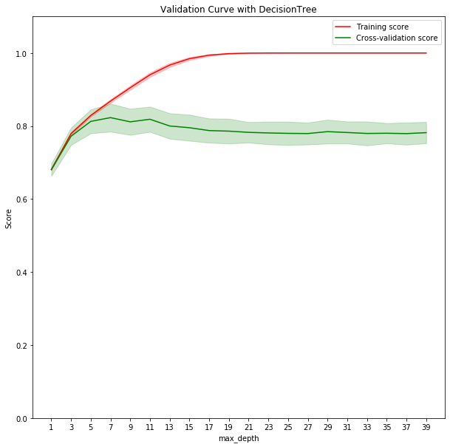
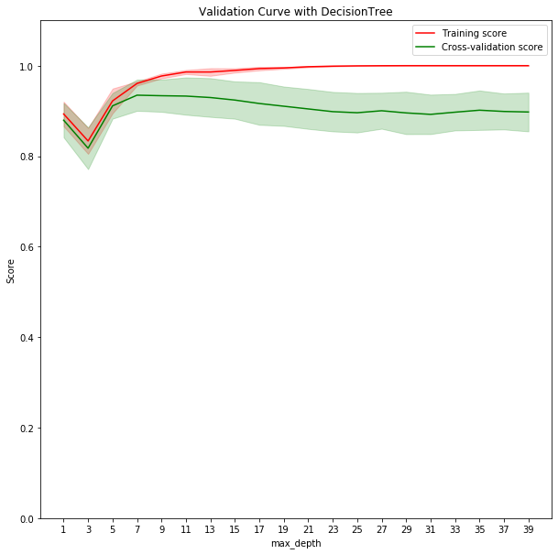
The graphs demonstrates the overfitting scenario in Decision Trees algorithm as we increase the depth of the tree. Both the training curve and validation curve are plotted along with variance (around 1 standard deviation). From the graphs, we can infer that the validation score decreases as the depth of the tree increases, we can observe the overfitting.
In data with smoking status as the depth becomes > 7 the training score goes on increasing while the validation score decreases.
In data with non-smoking status as the depth becomes > 8 the training score goes on increasing while the validation score decreases.
With Smoke Status
Without Smoke Status

Slide 37
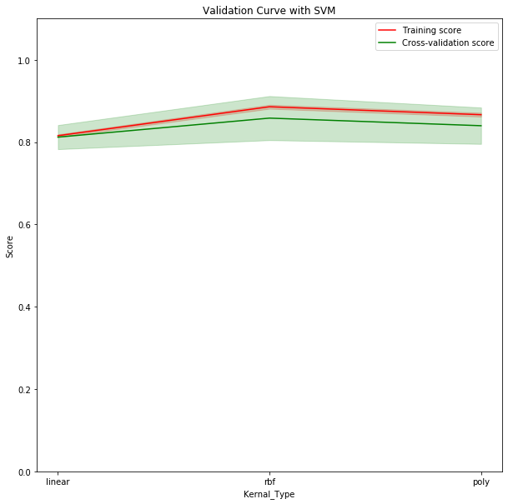
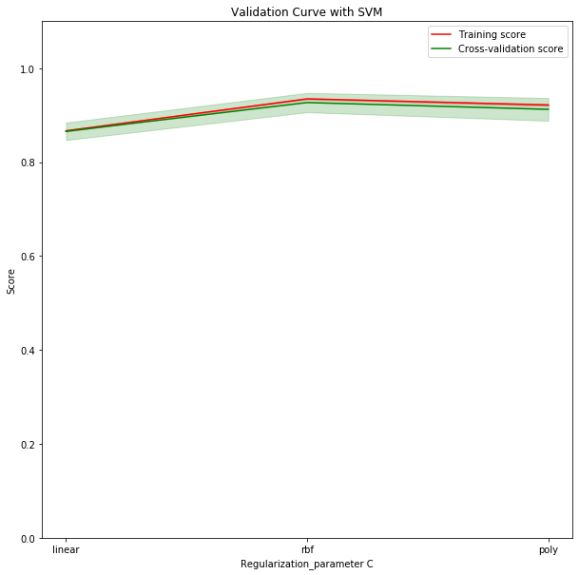
The below validation curves of SVM plots the relationship of the “kernel type" parameter to the F1 score with 10 shuffle split cross-validation. We can observe that when kernel type is ‘rbf’, we have the optimal results.
With Smoke Status
Without Smoke Status

Slide 38
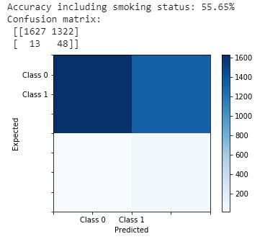

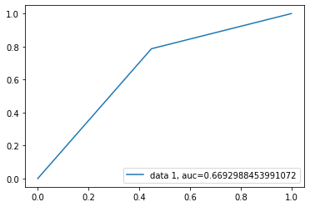
Confusion matrix and Roc after optimizing the data including smoking status
Decision Trees
Support Vector Machines

Slide 39


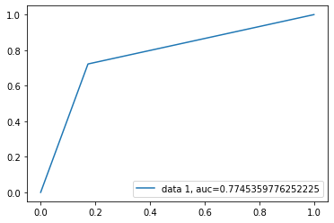
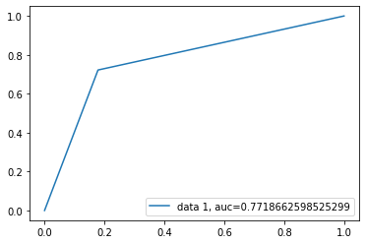
Confusion matrix and Roc after optimizing the data not including smoking status
Decision Trees
Support Vector Machines

Slide 40
Summarised results
WITH SMOKING STATUS | DECISION TRESS | SUPPORT VECCTOR MACHINES
Before optimized parameter | 0.6470 | 0.6694
After optimized parameter | 0.6692 | 0.6694
WITHOUT SMOKING STATUS | DECISION TRESS | SUPPORT VECCTOR MACHINES
Before optimized parameter | 0.6270 | 0.7718
After optimized parameter | 0.7745 | 0.7718

Slide 41

deployment

Slide 42

We can develop a web based platform or an API
Deploying using real time model rather than static model
Quality feedback
Maintaining compute resources

Slide 43
questions
Q1. How does SMOTE balance data?
a. Randomly removes majority class data records.
b. Generates new instances from existing minority class data records based on nearest neighbors.
c. Creates copies of existing minority class data records.
d. Under-samples majority class based on cluster centroids.
Answer : B

Slide 44
questions
Q2. What are validation curves used for?
a. how an increase in learning comes from greater experience.
b. tells how clean the data is.
c. determine how effective an estimator is on data that it has been trained on .
d. Gives information on biased data.
Answer : C

Slide 45
questions
Q3. What is the purpose of Normalization (in data preparation)?
a. change the values of numerical columns in the dataset to a categorical scale, without distorting differences in the ranges of values.
b. change the values of numeric columns to a common scale, without distorting differences in the ranges of values.
c. change the values of categorical columns in the dataset to a numeric scale, without distorting differences in the ranges of values.
d. fills the null values of a column with mean values.
Answer : B

Slide 46
Thank You

